Slide 1

Healthcare Analytics
FINAL PRESENTATION: ANALYSIS OF HEALTHCARE FACILITIES IN CONNECTICUT USING DBEAVER
OPIM 5272
December 8th 2022

Slide 2







TEAM 9
Kunal Lawangare
Rohit Ghosh
Shilpi Gupta
Keerthana Vangury
Lahari Maddula
Naveen Abboju

Slide 3

AGENDA
Introduction
Business Case
ER Diagram
Reports & Analysis
Challenges
Recommendations
Conclusion
References

Slide 4
1. INTRODUCTION
Our dataset comprises of the information on Healthcare facilities in Connecticut.
We have a total of 5 tables namely Pharmacies, Hospitals, Patients, company_type and City
Pharmacies have Pharmacy_Id, Pharmacy_name, Pharmacy_city, Pahrmacy_state, Type_of_Medicine, Stock_amount.
Patients have Patient_id, Patient_name, Type_of_visit, Hospital_Id
Hospital have Hospital_Id, City_Id, Hospital_name, Hospital_address, Hospital_zipcode, Hospital_status
City have City_Id, City_name, Population, Income, Zip_code
Pharmacy_details have Pharmacy_Id, Pharmacy_name, City_Id
Company_type have Pharmacy_name, Pharmacy_Id, Pharmacy_business

Slide 5
2. BUSINESS CASE
Our goal through this project is to create a database that could keep track of all the essential information about the Healthcare facilities in CT which can benefit both the public and private sector organizations as well as patients who are seeking the right kind of care.

Slide 6
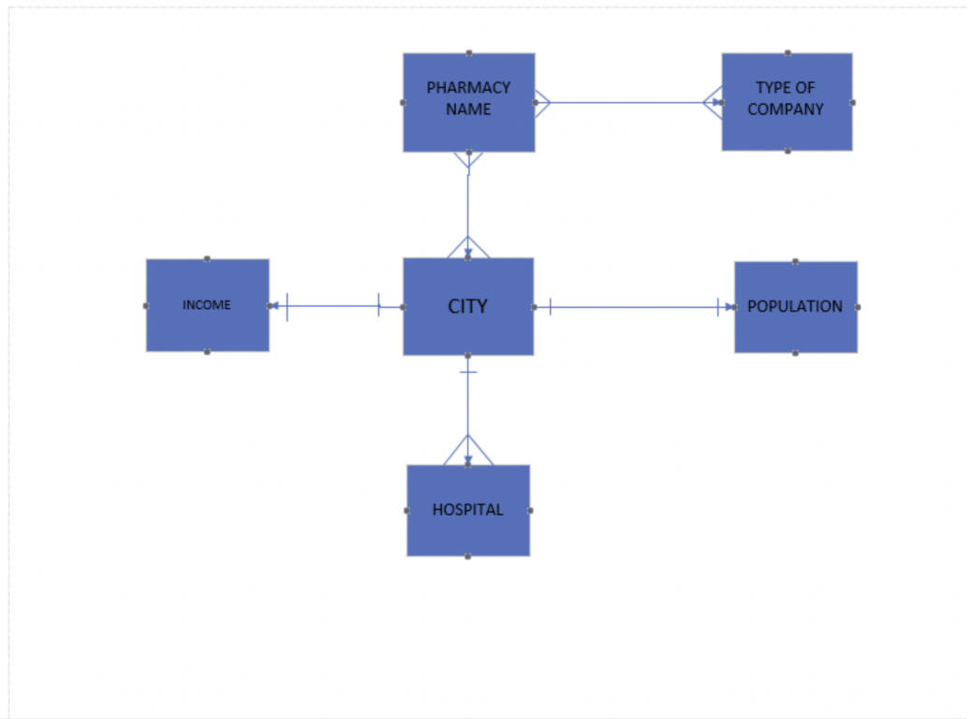
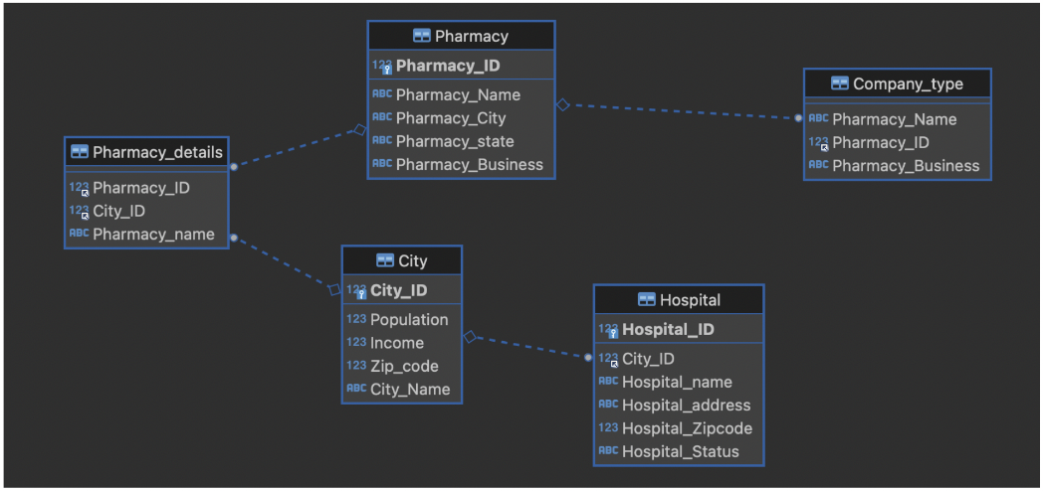
3. Initial ER DIAGRAM
Second Iteration
First Iteration

Slide 7
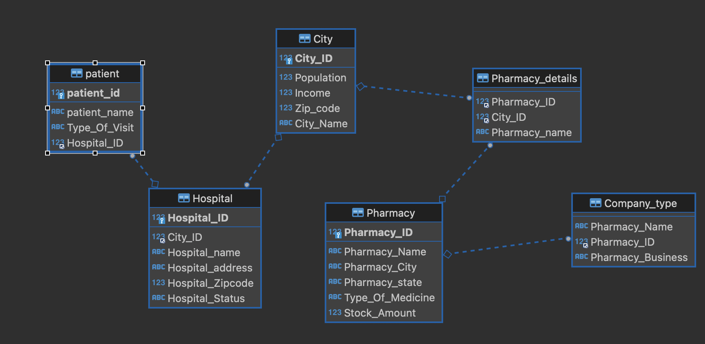
3. Final ER DIAGRAM

Slide 8
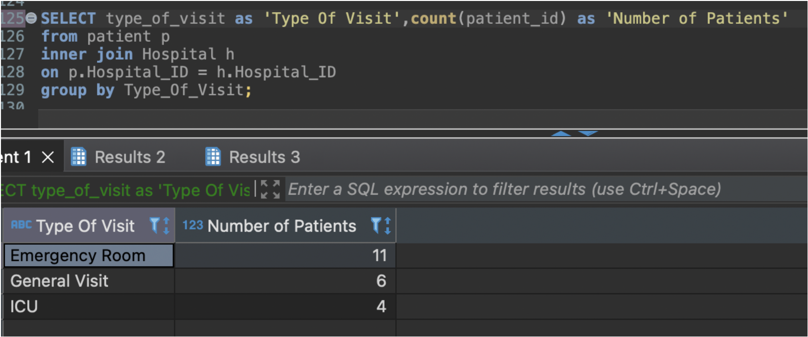
4. REPORTS & ANALYSIS
i) Number of visits in a hospital for certain type?
We took three different types of visits in the dataset.
We can see that the number of visits in the Emergency Room are more than any other type.
This shows that the hospitals should be prepared for more number of emergency rooms.

Slide 9
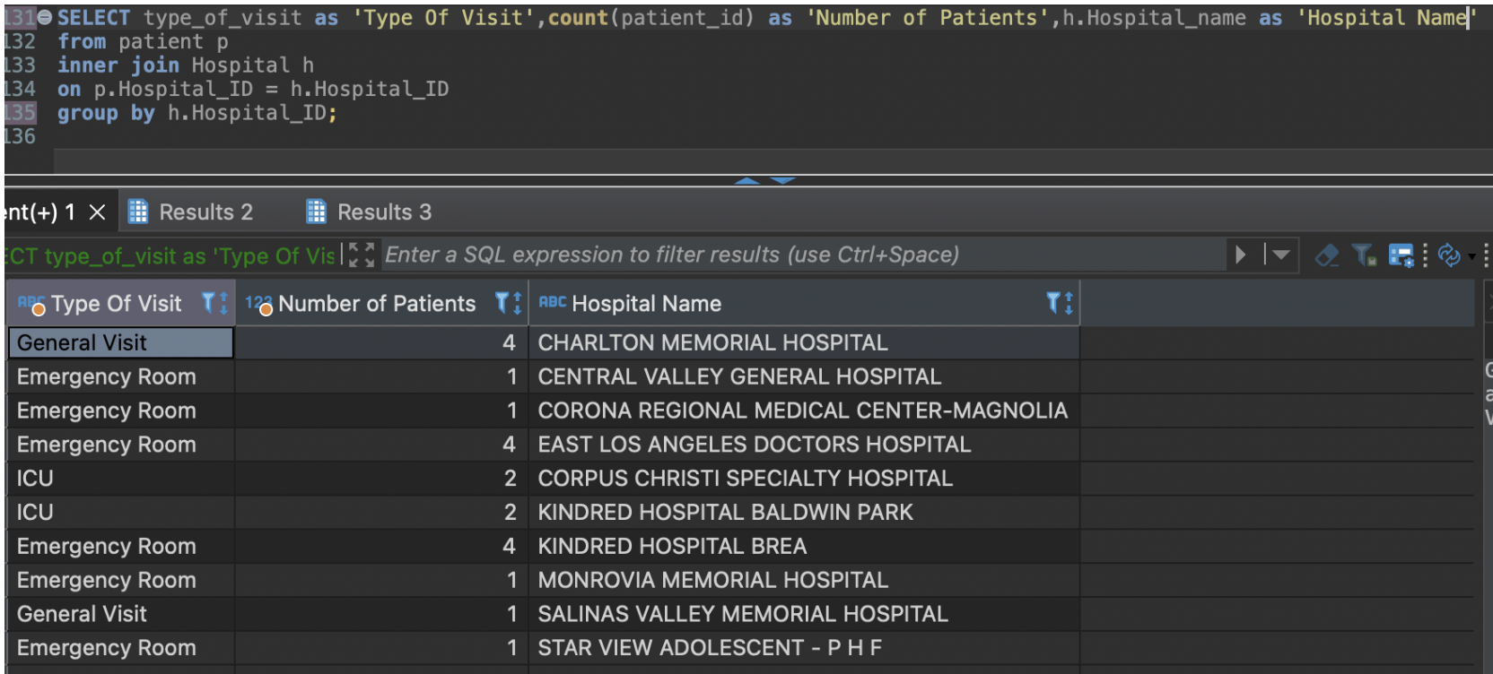
4. REPORTS & ANALYSIS
ii) Number of visits in a hospital for certain type in particular hospitals?
This displays the number of patients who visited a particular hospital for different types of reasons.
This can help the public and private hospitals to ensure there is enough staffings of MDs, surgeons and specialists.

Slide 10
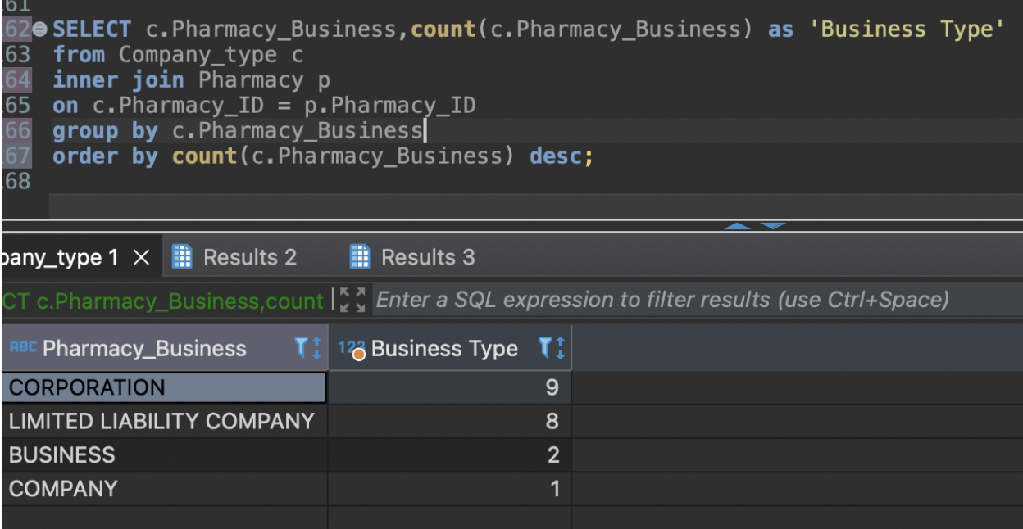
4. REPORTS & ANALYSIS
iii) What kind of business type is a pharmacy?
Identifying a pharmacy type can help us find the cost of medications in each type of pharmacy.
An LLC would for example might have a higher price of a medicine as compared to others.
This information can in turn help patients find a suitable pharmacy in their neighbourhood which sells cheaper medicines.

Slide 11
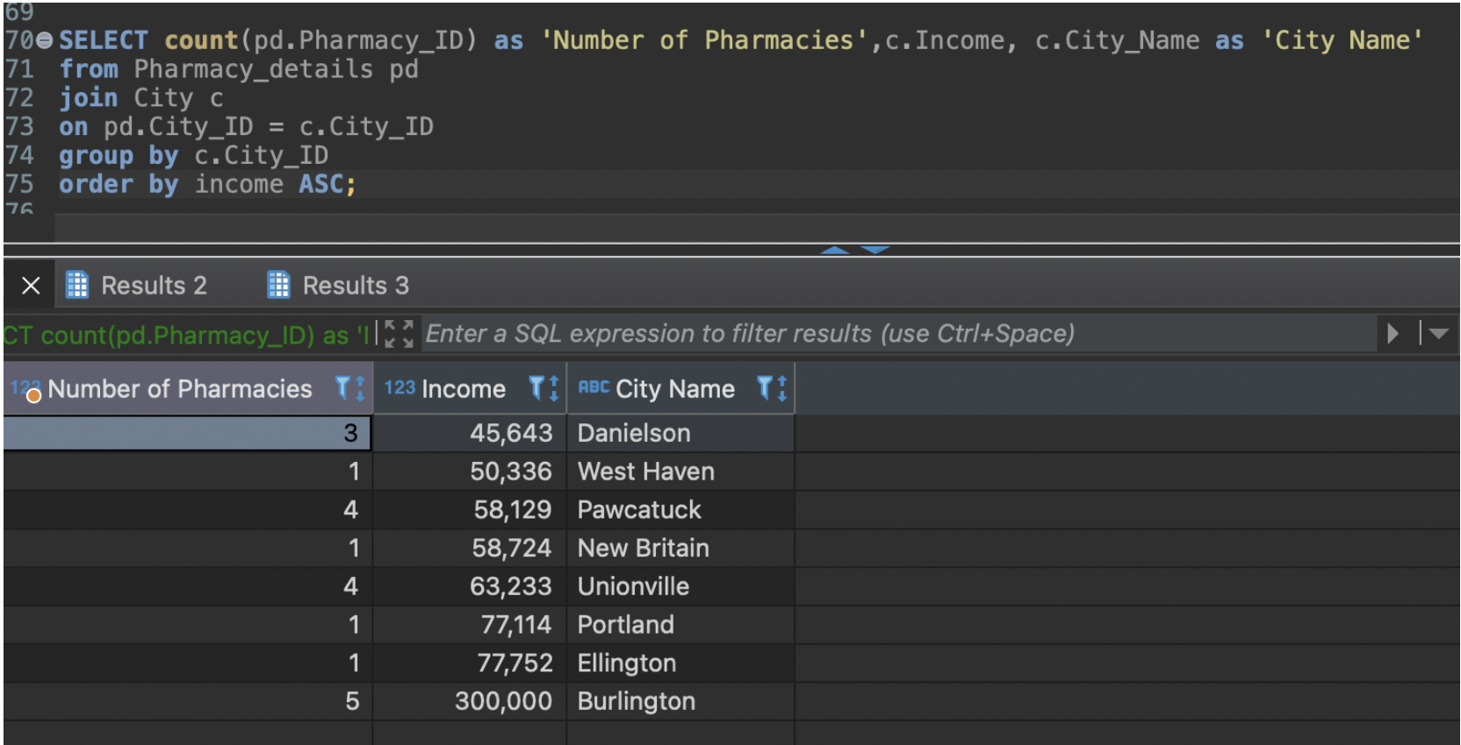
4. REPORTS & ANALYSIS
iv) Number of Pharmacy facilities in a low earning neighbourhood?
This information will be useful for the people to find pharmacies in their localities.
Families can find number of pharmacies in a location if they are planning to move there.
Public and Private organization can plan establishment of pharmacies and hospitals in locatilities that has a lack of it.

Slide 12
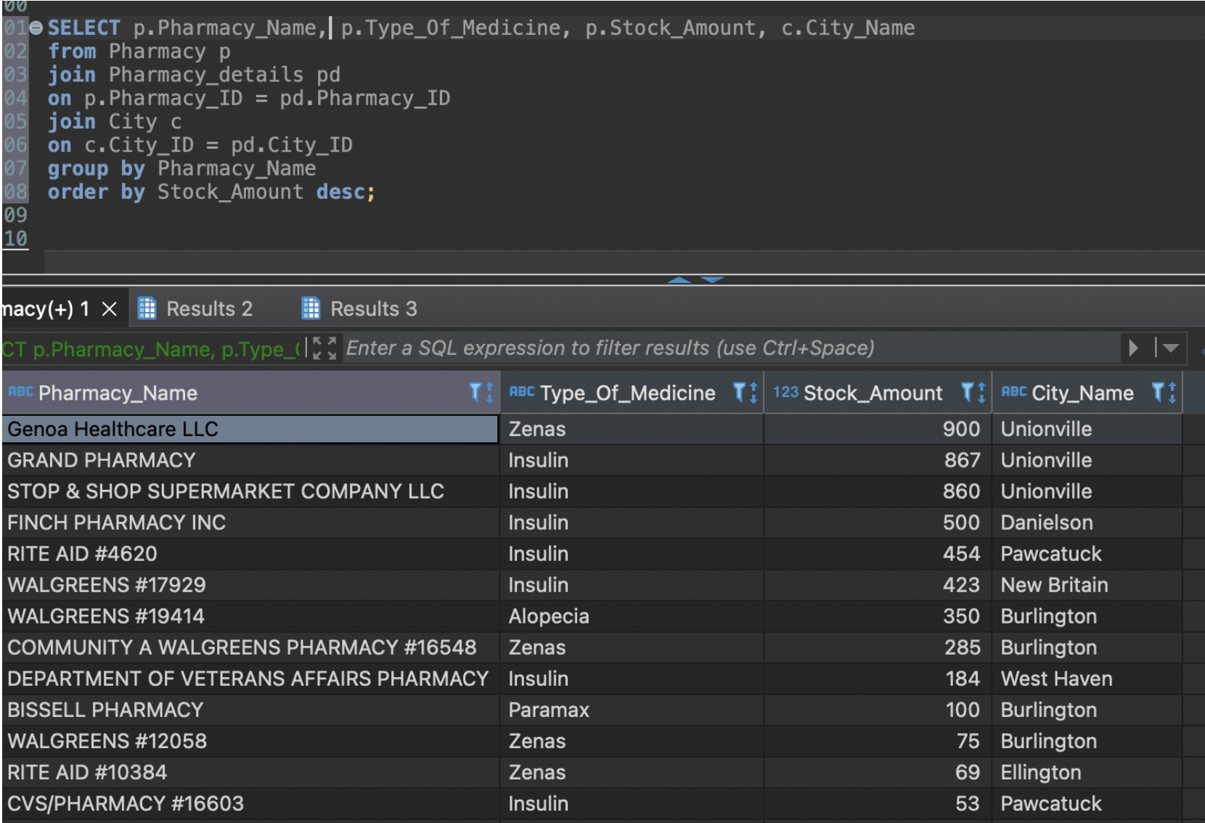
4. REPORTS & ANALYSIS
v) Types of medicines and stock amount in the Pharmacy?
This displays the pharmacy name and the particular type of rare medicines with it’s stock amounts.
From this we can find out where there is a medicine shortage is in the pharmacy so that they can restock it.

Slide 13
5. CHALLENGES
Faced difficulty in finding external datasets and in linking them with the main data set.
We had to add more columns due to limited data in the pharmacy data set.
Faced difficulty in designing initial model ERD.

Slide 14
6. RECOMMENDATIONS
We can extend this data set in finding the relation between pharmacy business and licensing.
We can use this in finding the operational hours of the pharmacy whose revenue is high.
Also, we can the link the hospitals and pharmacies with the insurance companies.
These data sets can be improved by adding information related to doctors, ambulances, medical equipments which can help the stocking and maintenance of hospitals.

Slide 15
7. CONCLUSION
After running the above queries, we are successfully able to find
Number of visits in a hospital for certain type
Number of visits in a hospital for certain type in particular hospitals
Kind of business type is a pharmacy
Number of Hospital facilities in a low earning neighbourhood
Types of medicines and stock amount in the Pharmacy

Slide 16
8. REFERENCES
My Data set
https://data.ct.gov/Health-and-Human-Services/Pharmacies/2rnd-twzt/data
External Data Sets
https://www.kaggle.com/datasets/goldenoakresearch/us-household-income-stats-geo-locations
https://www.kaggle.com/datasets/andrewmvd/us-hospital-locations
https://data.opendatasoft.com/explore/dataset/georef-united-states-of-america-zc-point%40public/table/
https://data.ct.gov/Health-and-Human-Services/Pharmacies/2rnd-twzt/data

Slide 17
Thank You

Slide 18
Questions?

